Slide 1


MILLENIUM FELLOWSHIP
Presented By: Khadija Dahira Baba

Slide 2
Outline
Title
Intro
Cohorts
Overview of Projects
Description of Projects
Lessons Learned
Class of 2025
Conclusion
How to Navigate Us

Slide 3
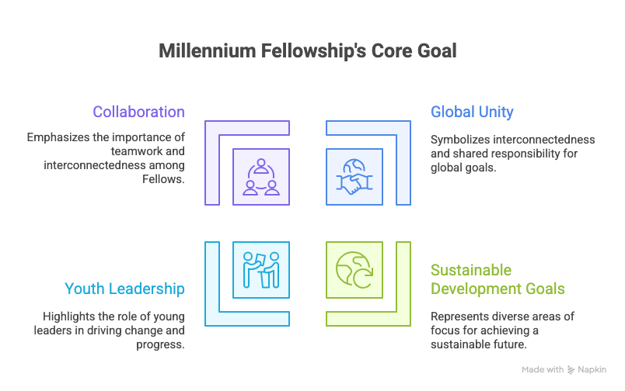
Introduction
What Is Millenium Fellowship
Is a semester-long, global leadership development program for undergraduate students, run by the Millennium Campus Network (MCN) and United Nations Academic Impact (UNAI), focused on empowering students to create social impact and advance the UN's Sustainable Development Goals (SDGs) through campus-based projects, training, and a worldwide network of peers.
Notes:
The Millenium fellowship is a program organized by MCN and UNAI to teach students across campuses globally on leadership, social impact ,SDGs and give them access to a global platform to showcase their talents and projects.
Northwest UNiversity cohort joined to be part of this great move,we are the first fellows from the university and our motivation was simple Learn and Impact
we joined MF to learn from the diverse knowledge and resources available and use what we have learned to influence change in our communitites and localities.

Slide 4
Meet Our Campus Cohort (Class of 2025)
CAMPUS DIRECTORS
Ummsalamah Adenike Musa
Fatima Mustapha
FELLOWS
Khadija Dahira Baba
Maryam Dalhatu
Muhammad Hanga
Oluwadamilola Shona
Suwaiba Umar Idris
Ibikunle Folake Emmanuella
Notes:
The MF of Northwest University class of 2025 were amongst the lucky few to be selected out of about more than 20 applicants. which is an amazing achievement for both us and the university

Slide 5
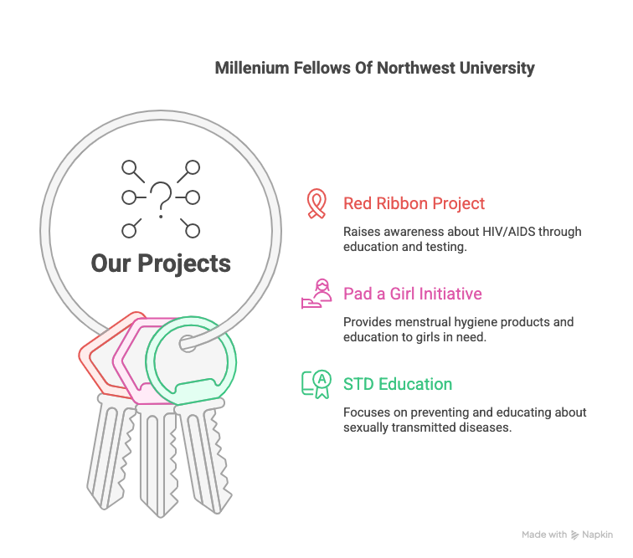
Overview of Our Projects
Notes:
The fellows had an intensive in-person and online training sessions where we where taught on how to make social impact.We tried implementing what we assimilated from these sessions by dividing ourselves into three main projects aligning mainly to SDG 3 ;Healthcare and wellbeing.
The three projects focused on locals and underserved communties who need them the most.
these projects are:

Slide 6
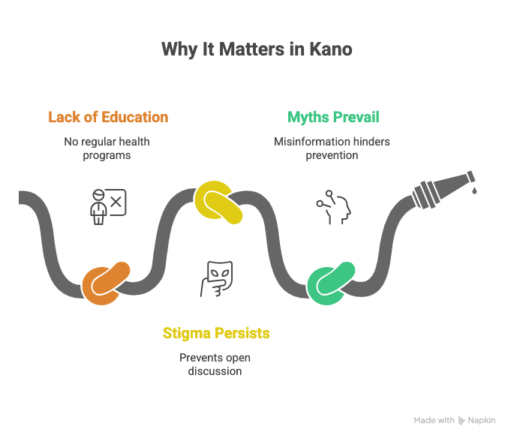
The Red Ribbon Project
Population Targeted:
Travelers, Drivers Hawk-girls and Motor-park workers.
SDG Aligned:
SDG 3; Healthcare and Wellbeing
SDG 10; Reduced Inequalities
Team Members:
Muhammad Hanga
Ibikunle Folake Emmanuella
Maryam Dalhatu
Activities:
Talk on HIV/AIDs
Free HIV testing
Impact:
Targeted over 150 people
Tested about 50
Location:
Rijiyar Zaki Motor-park
Notes:
The red ribbon project focused mainly on HIV awareness. HIV knowledge is still low among commercial drivers, travelers, and motor-park workers a population with higher exposure to due to risky behaviors and limited access to accurate health information.
The lack of education, Misinformation, stigma and high risk factors of these individuals made them a perfect audience. The activities conducted are talks on HIV, its effect and consequence on their health and preventive measures. The project successfully targeted over 150 individuals and tested about 50 . Individuals on these project are :

Slide 7
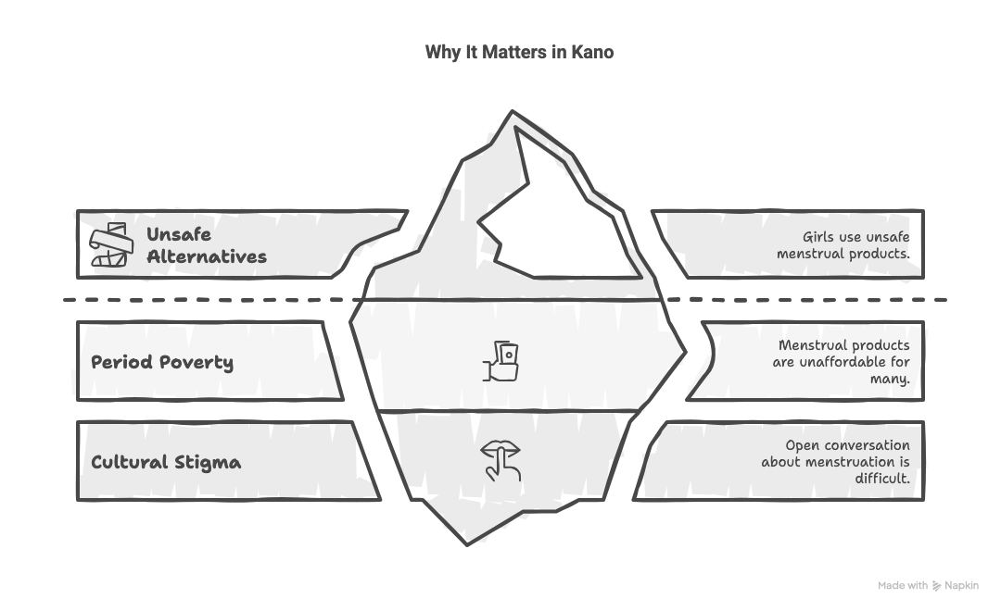
Pad a Girl Initiative
Population Targeted:
Young secondary school girls between age 13-18
SDG Aligned:
SDG 3; Healthcare and Wellbeing
SDG 4; Good Education
SDG 5; Gender Equality
Team Members:
Khadija Dahira Baba
Ummsalamah Adenike Musa
Suwaiba Umar Idris
Fatima Mustapha
Activities:
Talk on Menstrual Hygiene
Free Pads
Impact:
Targeted over 50 young girls
Distributed about 50 Pads
Location:
Huzaifatil Yamani Litahfizul Quran wattarbiyyah Al-Islamiyya Ado-bayero Layout
Notes:
pad a girl initiative was conducted at an islamic secondary school(islamiyya) which was the first of its kind and it targeted young secondary school girls and enlighntened them on Mentrual hygeine.
A lot of girls and young women lack access to affordable sanitary pads and proper menstrual hygiene education, leading to school absenteeism, infections, and shame. and pad a girl initiative wanted to bridge this gap.We educated about 50 girls on menstrual hygiene its effect on their health and consequences of r hygiene,also 50 pads were distributed amongst these young girls.

Slide 8
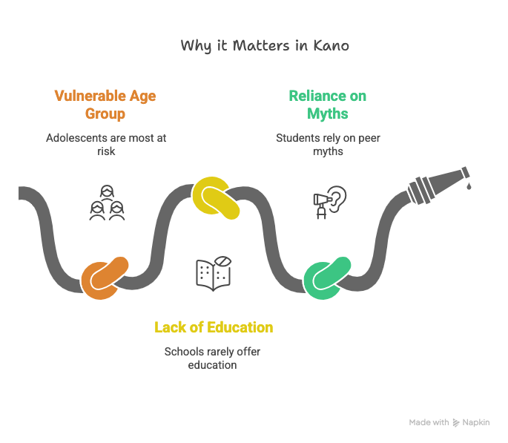
Sexually Transmitted Diseases
Population Targeted:
Secondary School Students.
SDG Aligned:
SDG 3; Healthcare and Wellbeing
SDG 10; Reduced Inequalities
Team Members:
Oluwadamilola Shona
Activities:
Talk on STIs
Impact:
Targeted about 50 students
Location:
Standard Comprehensive Secondary School Sabon gari
Notes:
The prevelence of STI amongs adolescents is somewhat about 4-15% which is an indication for more STI awarness amongst these groups.Teenagers lack accurate knowledge about sexually transmitted infections, leading to risky behaviors, stigma, and late treatment.they rely on info from peers which mostly is misleading.With this STI project these groups were targeted and addressed, More than 50 students were enlightened and their misconceptions was cleared

Slide 9
Lessons Learned
Personal Leadership Growth
Teamwork Experience
Community Insights
Inclusivity
Humility
Empathy
Partnership
Notes:
We learned how to step up even when things felt overwhelming from planning outreach to speaking in front of strangers and reaching to these individuals.
Tme management was part of the things we picked frokmMF between school, fellowship tasks, and attending these outreaches we learned how to lead with discipline and intentionality. We became more confident handling sensitive topics like HIV, menstruation, and STIs
we also learned how to coexit to stand as one even in diverse situations, we learned to communicate and understand each other rely on each other
It also gave us insights about the problems of our community , made us realize its not that hard to approach people and impact in our communities
we also got to know about inclusivity involving and engaging the communities not just beneficiaries of the projects but part of it.
approachin these communities and individuals with empathy, humilty and grace was also part of what we gained from MF.We also partnered with different associations and organizations for the success of these outreaches.

Slide 10
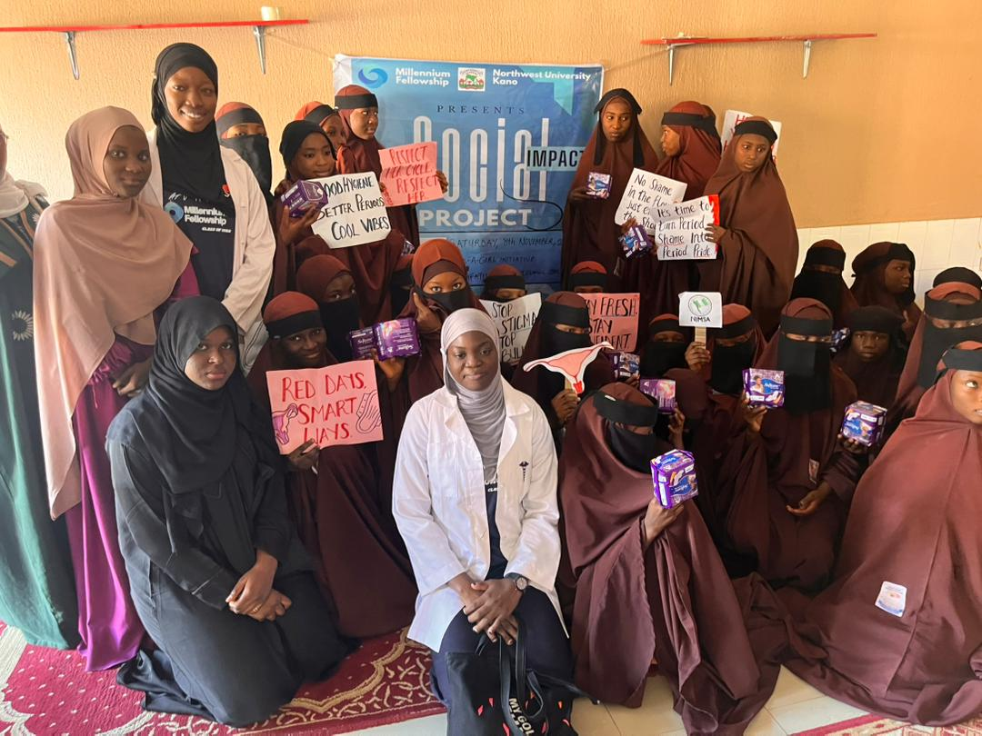
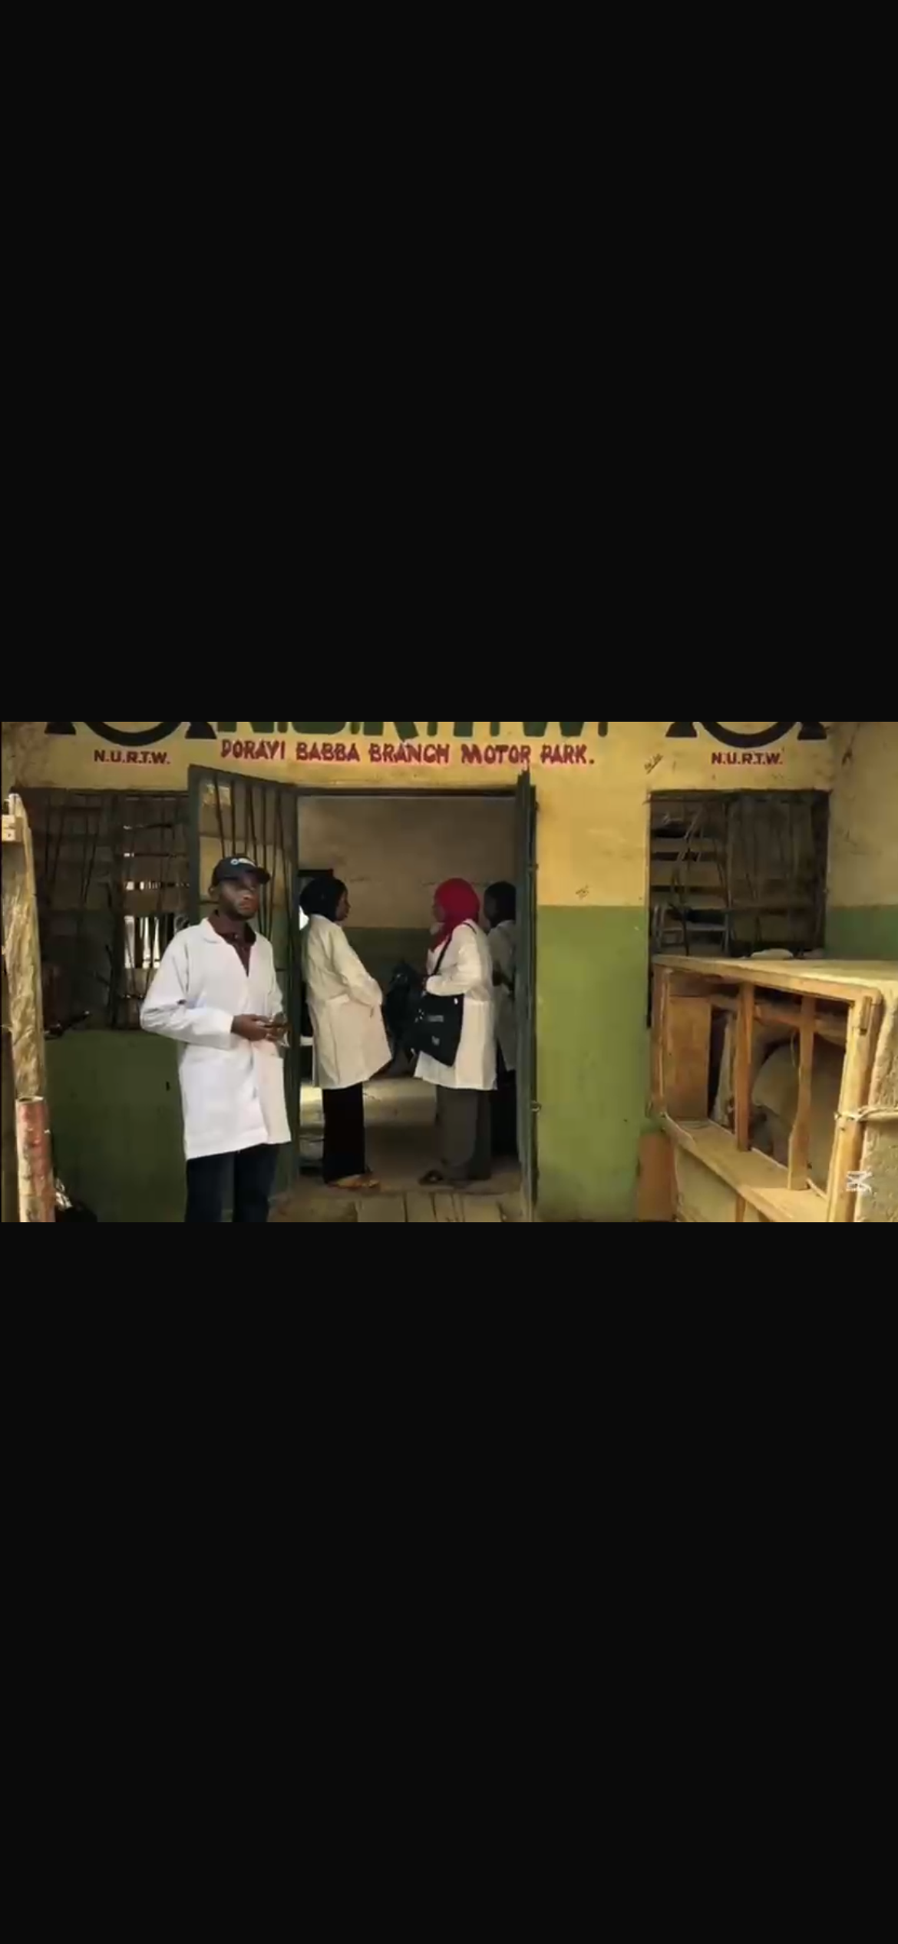
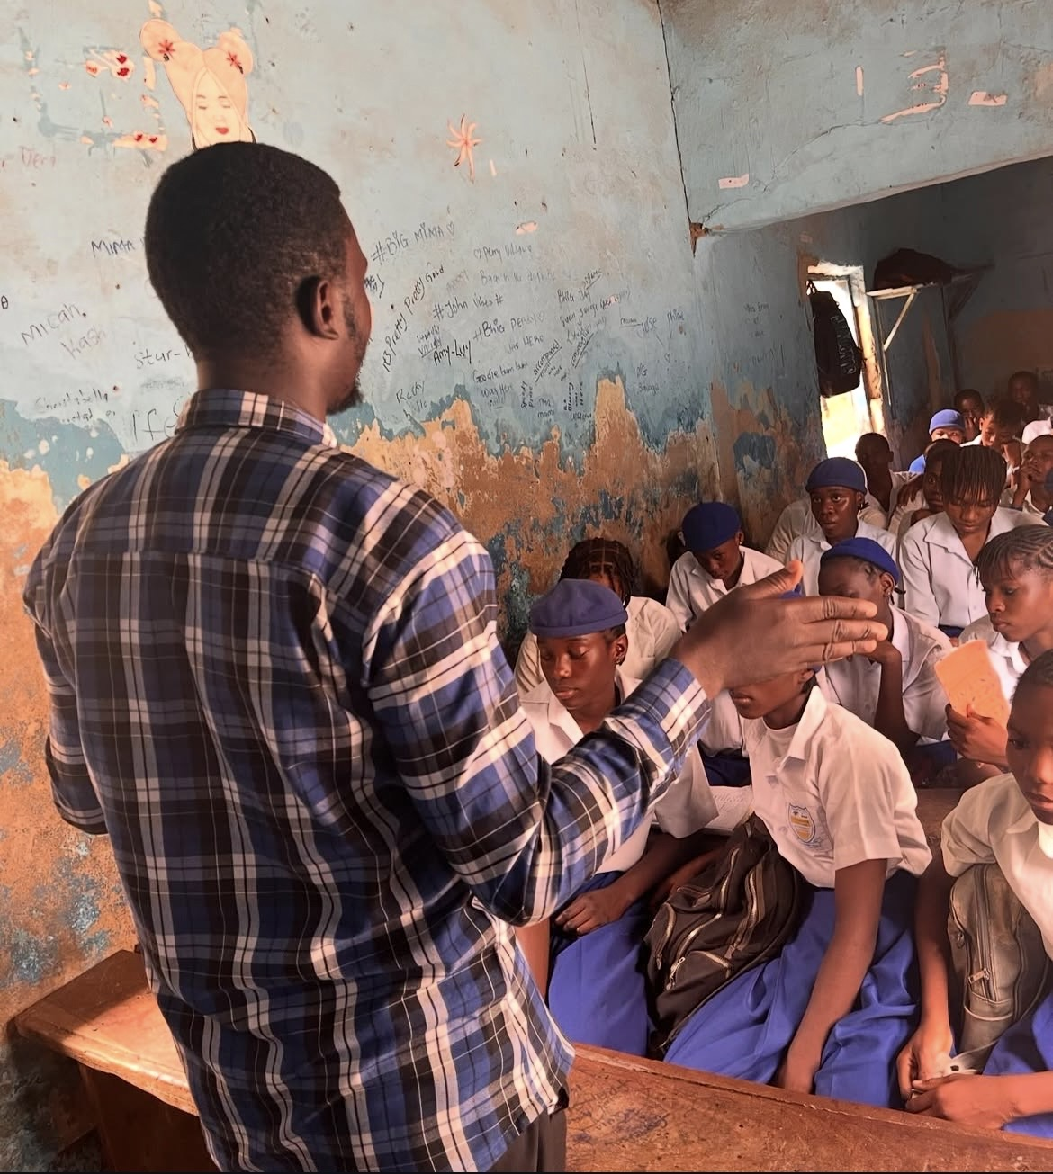
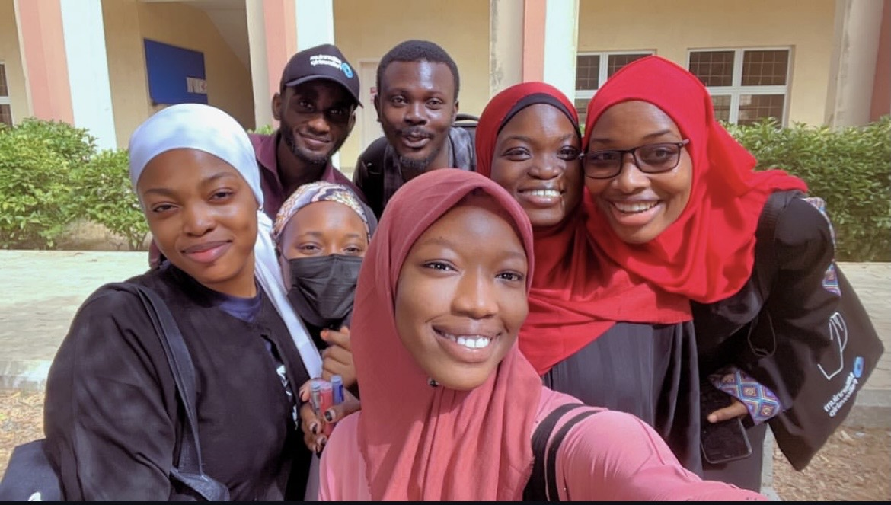
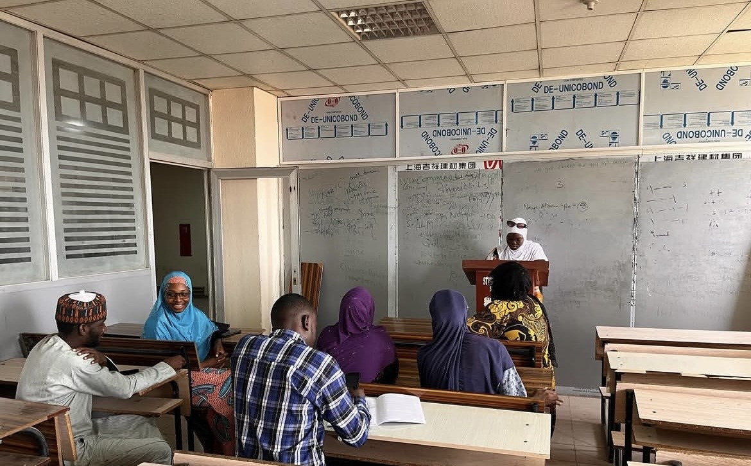
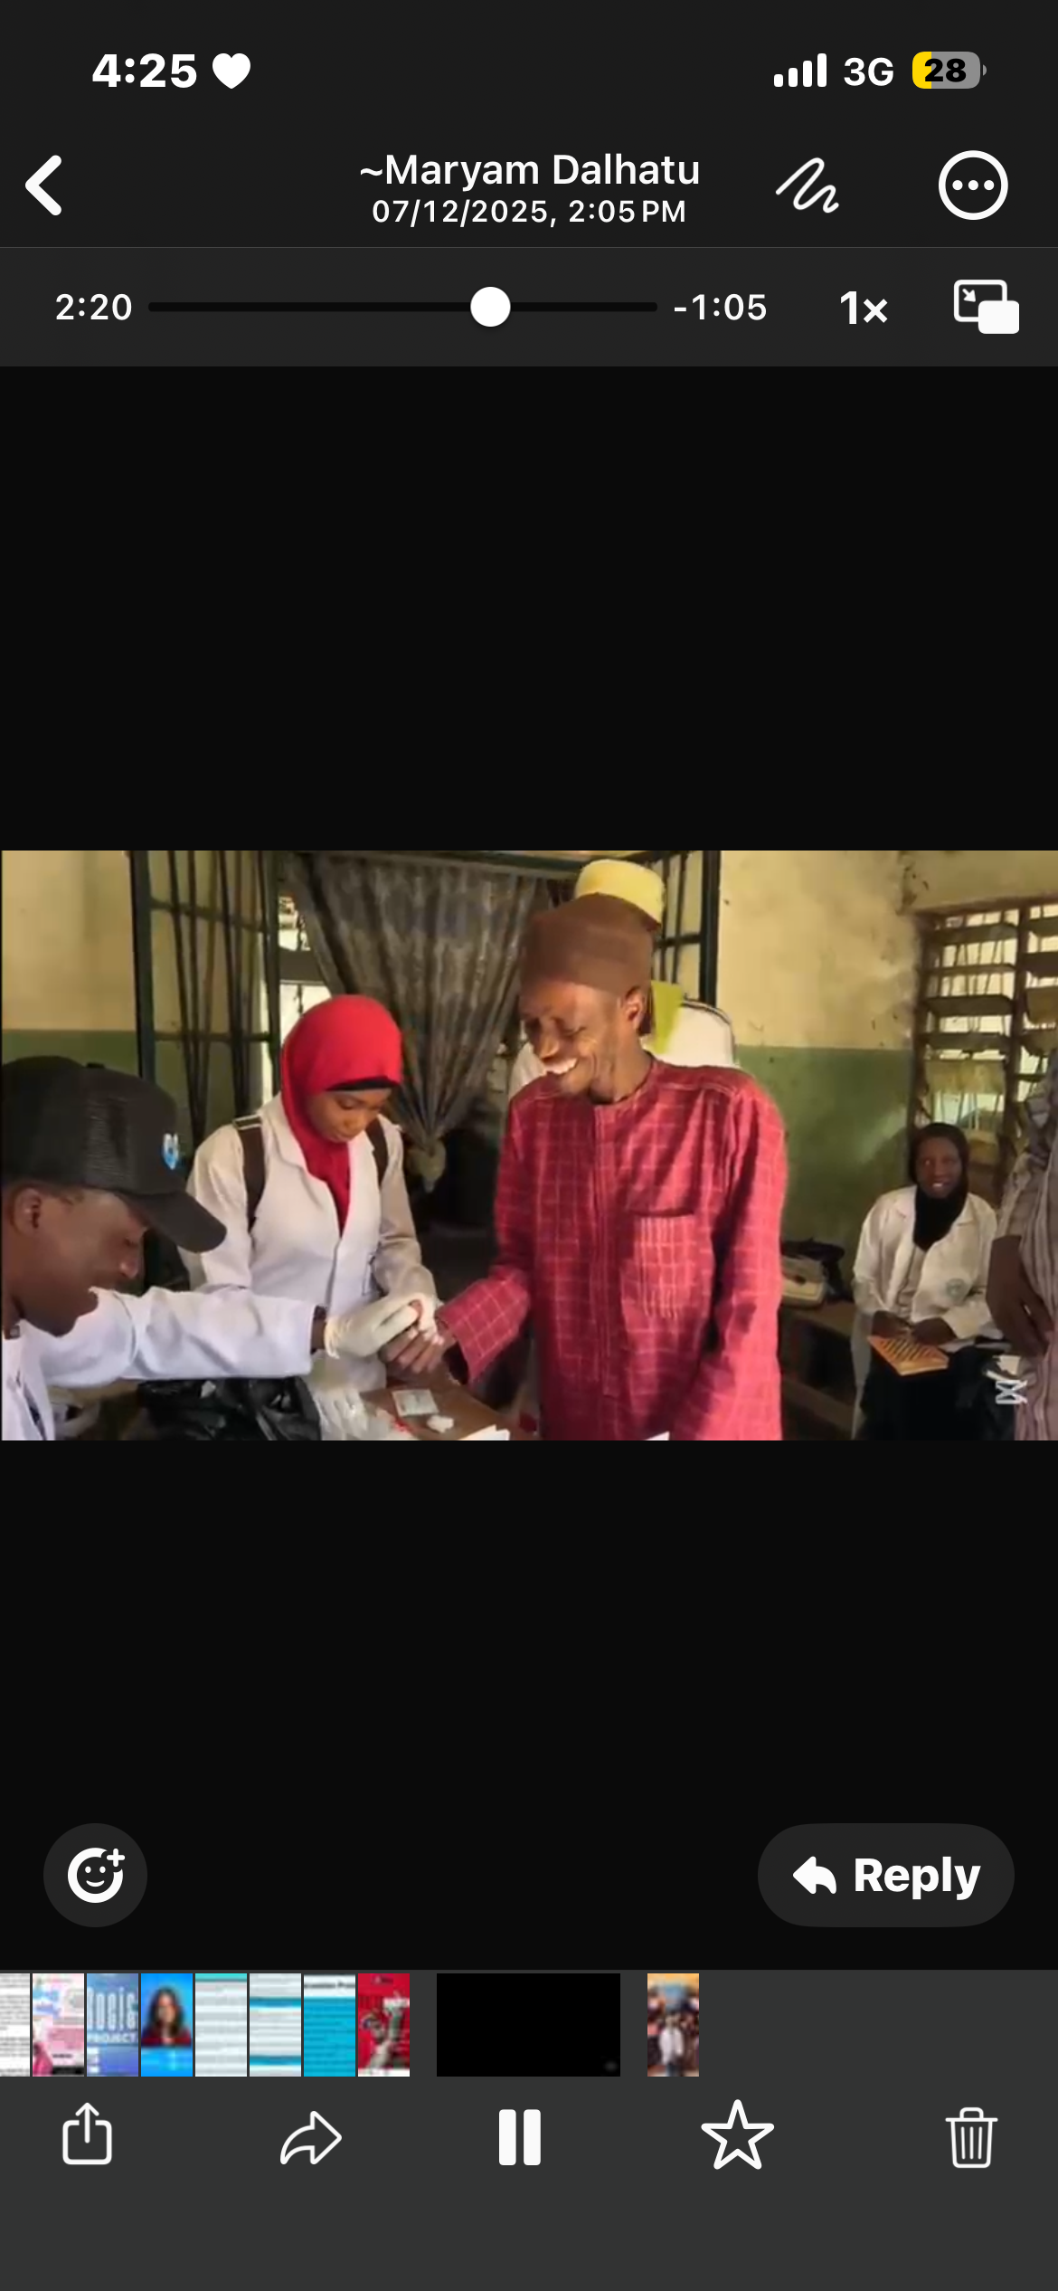
Red Ribbon
Pad a Girl Initative
Sexual Transmitted Disease
Millenium Fellow Class of 2025
Northwest Campus

Slide 11
Conclusion
Our Impact
Red Ribbon, STI and Pad a Girl initaitive sparked real change and community awareness
Sustainability
Students: Sign up for millennium fellowship 2026 ,join the movement and lead with purpose
University:partner with students and provide support
Notes:
Our three projects — Red Ribbon, Pad a Girl, and STI Awareness for Secondary Schools showed us how intentional youth-led action can create real impact in the community. As we move forward, we’re committed to keeping the momentum alive through ongoing collaborations, recruiting new student volunteers, and building stronger partnerships so the work continues beyond the Millennium Fellowship year.
We extend our sincere gratitude to the Millennium Fellowship Team, our university administration, our mentors, volunteers, partners, and every community member who trusted us and engaged with our outreach. Their support made each project possible and pushed us to lead with purpose, sincerity, and service.
If you believe in positive change — join Millennium Fellowship 2026. Together, we can uplift communities, break barriers, and lead with sincerity.”

Slide 12
How to Navigate Us
To apply for MF class of 2026
Millennium Fellowship:www.millenniufellows.org
Lets stay connected at
NWU_Chapter: www.instagram.com/millennium_fellowship_nwu

